Slide 1



Noida Institute of Engineering and Technology, Greater Noida
Introduction of Wireless Communication
Unit: 3
Wireless Communication
AOE-0772
Mr.Rishi Singhal
Assistant Professor
EN
Course Details (B. Tech 7th Sem)

Slide 2
WIRELESS COMMUNICATION
Content
Course Contents / Syllabus
UNIT-I |  | Introduction of Wireless Communication | 8 Hours
History and evolution of mobile radio systems, General Model of Wireless Communication Link, Types of mobile wireless services/systems-Cellular, WLL, Paging, Satellite Systems, Future trends in personal wireless systems.
UNIT-II | Cellular Concepts and System Design Fundamentals |  | 8 Hours
Cellular Infrastructure, Cellular System Components, Antennas for Cellular Systems, Operation of Cellular Systems, frequency reuse, channel assignment, handoff strategies, Interference and system capacity.
UNIT-III | Mobile Radio Propagation Models |  | 8 Hours
Radio wave propagation issues in personal wireless systems, Propagation models, Channel Noise and Losses, Fading in Land Mobile Systems, Multipath Fading, Fading Effects on Signal and Frequency, Shadowing; Wireless Channel Modeling: AWGN Channel, Rayleigh Channel,
UNIT- IV | Equalization, Diversity Techniques & Multiple Access Techniques |  | 8 Hours
Equalization, Rake receiver concepts, Diversity Techniques, Linear predictive coders and channel coding. Multiplexing and Multiple Access: FDMA, TDMA, CDMA, OFDMA, Multiple Access for Radio Packet Systems: Pure ALOHA, Slotted ALOHA, CSMA and their versions; Packet and Pooling Reservation Based Multiple Access Schemes.
UNIT-V | Wireless Systems & Standards |  | 8 Hours
GSM system for mobile Telecommunication, General Packet Radio Service, Edge Technology; CDMA 2000, IMT 2000 and UMTS, Long Term Evolution (LTE), Introduction to Mobile Adhoc Networks, Li-Fi Communication, Ultra-Wideband Communication, Mobile data networks, Introduction to 4G, 5G and concept of NGN.

Slide 3
WIRELESS COMMUNICATION
Content
Course Outcomes: After completion of this course students will be able to
CO 1 | Explain with various generations of mobile communications. | K1, K2
CO 2 | Explain concept of cellular communication. | K2
CO 3 | Describe the basics of wireless communication. | K2
CO 4 | Explain and differentiate contention free and contention based multiple access techniques. | K2,K4
CO 5 | Explain Various modern wireless technologies. | K2

Slide 4
WIRELESS COMMUNICATION
Content
Text Books:
T.S. Rappaport, “Wireless Communication-Principles and practice”, Pearson Publications, Second Edition.
2. Upena Dalal, “Wireless Communication and Networks”, Oxford Press Publications.
3. T L Singal ,“Wireless Communications ”, McGraw Hill Publications.
Reference Books:
1. Andrea Goldsmith, “Wireless Communications”, Cambridge University Press.
2. S. Haykin & M. Moher, “Modern wireless communication”, Pearson, 2005.
NPTEL/ YouTube/ Faculty Video Link:
Unit 1 | https://youtu.be/JCGMP37-2EA
Unit 2 | https://youtu.be/f2wlHL1Sok8 https://youtu.be/0PWILK-hqbQ
Unit 3 | https://youtu.be/SFcRtZ30rqs https://youtu.be/BKf2mN9W6Nk https://youtu.be/tePZhxRLsjE
Unit 4 | https://youtu.be/GLmF3YB0pQU https://youtu.be/QHqZwBoTJRY
Unit 5 | https://youtu.be/t3FVP5wuG4g https://youtu.be/ixY0Cau4mBM

Slide 5
Content
Radio wave propagation issues in personal wireless systems
Propagation models
Channel Noise and Losses,
Fading in Land Mobile Systems,
Multipath Fading
Fading Effects on Signal and Frequency
Shadowing; Wireless Channel Modeling
AWGN Channel
Rayleigh Channel
Faculty Video Links, YouTube and NPTEL Video Links, and Online course details
Daily Quiz
Weekly Assignment
MCQs
Expected Questions for University Exam

Slide 6
Course Objective
To make students familiar with fundamentals of wireless communication systems.
2. To choose system (TDMA/FDMA/CDMA) according to the complexity, installation cost, speed of transmission, channel properties etc.
3. To identify the requirements of wireless communication as compared to static communication.
4. To identify the limitations of 2G and 2.5G wireless mobile communication and use design of 3G and beyond mobile communication systems.
5. To identify various modern wireless technologies.

Slide 7
Unit Objective
In this unit students will be able :
To familiar with fundamentals of wireless communication systems.
To study various fading models.
To study Radio wave propagation and its architecture.

Slide 8
Course Outcome
After completion of the course student will be able to
CO1. Explain various wave propagation of mobile communications.
CO2. Explain the concept Propagation models ,Channel Noise and Losses communication.
CO3. Describe the multipath fading of wireless communication.
CO4. Explain and differentiate AWGN Channel, Rayleigh Channel techniques.
CO5. Explain Various type of fading wireless technologies.

Slide 9
CO-PO and PSO Mapping
Mapping of Course Outcomes and Program Outcomes:
S.No | Course Outcome | PO1 | PO2 | PO3 | PO4 | PO5 | PO6 | PO7 | PO8 | PO9 | PO10 | PO11 | PO12
1 | KEC-076.1 | 2 | 2 | 1 | 1 | 2 | 2 | 2 | 2 | 2 | 2 | 1 | 3
2 | KEC-076.2 | 2 | 2 | 2 | 2 | 1 | 2 | 2 | 2 | 2 | 3 | 1 | 2
3 | KEC-076.3 | 3 | 1 | 2 | 1 | 2 | 2 | 1 | 1 | 2 | 3 | 2 | 2
4 | KEC-076.4 | 3 | 1 | 1 | 1 | 3 | 3 | 2 | 1 | 1 | 3 | 1 | 2
5 | KEC-076.5 | 2 | 1 | 2 | 2 | 3 | 3 | 2 | 1 | 2 | 3 | 2 | 2
6 | KEC-076.6 | 3 | 2 | 2 | 2 | 2 | 3 | 2 | 1 | 2 | 3 | 1 | 2

Slide 10
CO-PO and PSO Mapping
Mapping of Program Specific Outcomes and Course Outcomes:
S.No | Course Outcome | PSO1 | PSO2 | PSO3
1 | KEC-076.1 | 3 | 2 | 1
2 | KEC-076.2 | 3 | 3 | 1
3 | KEC-076.3 | 3 | 3 | 1
4 | KEC-076.4 | 2 | 2 | 1
5 | KEC-076.5 | 3 | 3 | 1
6 | KEC-076.6 | 3 | 3 | 1
 | Average | 2.83 | 2.66 | 1

Slide 11
Prerequisite and Recap
Basics of Propagation models
Channel Noise and Losses
Model of fading and multipath fading .

Slide 12
Topic Objective
Name of Topic | Objective of Topic | Mapping with CO
Introduction | Students will learn about basics of communication system | CO2

Slide 13
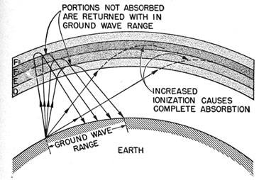
Radio wave propagation issues in personal wireless systems
Radio wave propagation issues in personal wireless systems refer to the challenges and obstacles that radio signals encounter as they travel through the air or other mediums to establish and maintain a wireless connection between devices, such as smartphones, laptops, and IoT devices. Understanding these propagation issues is crucial for designing efficient wireless communication systems. Below, radio wave propagation issues in personal wireless systems in detail:

Slide 14
Radio wave propagation issues in personal wireless systems
Free Space Path Loss (FSPL): As radio waves propagate through free space, they experience attenuation or signal loss over distance. This phenomenon is known as Free Space Path Loss (FSPL) and is described by the inverse square law. The signal strength decreases with the square of the distance from the transmitter. This means that as you move farther away from the source of the signal, the signal strength diminishes rapidly.
Multipath Interference: In urban environments, radio signals often encounter multiple reflective surfaces like buildings, walls, and other obstacles. When signals bounce off these surfaces and reach the receiver through different paths, they interfere with each other. This phenomenon is called multipath interference, and it can result in fading or signal degradation. Multipath interference is a significant issue in wireless communication systems, and various techniques such as diversity reception and equalization are used to mitigate it.

Slide 15
Radio wave propagation issues in personal wireless systems
Shadowing: Shadowing, also known as path loss due to obstacles, occurs when obstacles like buildings, trees, or hills block the direct line-of-sight path between the transmitter and receiver. This obstruction causes additional attenuation and signal loss. Shadowing can be particularly problematic in outdoor environments and at higher frequencies where signals have difficulty penetrating obstacles.
4.Fading: Fading refers to rapid variations in signal strength over short distances or time intervals. It can be caused by multipath interference, atmospheric conditions, or other environmental factors. Fading can be classified into two main types: slow fading (which occurs over larger distances) and fast fading (which happens over short distances or time intervals). To combat fading, wireless systems often employ techniques like adaptive modulation and coding or channel equalization.

Slide 16
Radio wave propagation issues in personal wireless systems
Absorption and Attenuation: Radio waves can be absorbed or attenuated by various materials and atmospheric conditions. For instance, water vapor, rain, and atmospheric gases can absorb and scatter radio signals, leading to signal loss. This is especially significant in microwave and millimeter-wave bands. Different materials have varying levels of signal absorption, so understanding the local environment is crucial for system design.
Multipath Delay Spread: Multipath delay spread occurs when signals arriving through different paths have different time delays. This can result in inter symbol interference, where symbols from one bit interfere with symbols from the adjacent bits. To address this issue, wireless systems use techniques like equalization to compensate for the time delays and maintain data integrity.

Slide 17
Radio wave propagation issues in personal wireless systems
Doppler Shift: The Doppler effect causes a shift in the frequency of a signal when either the transmitter or receiver is in motion relative to the other. This shift can lead to a change in the received signal's frequency and phase, which can affect the system's performance, especially in mobile communication systems.
Frequency-Dependent Propagation: Different frequencies behave differently in the same environment. Higher frequencies (e.g., millimeter-wave bands) are more susceptible to absorption by atmospheric gases and are less effective at penetrating obstacles, while lower frequencies (e.g., sub-6 GHz bands) tend to have better propagation characteristics in urban and indoor settings.
Interference: In addition to natural propagation challenges, personal wireless systems often face interference from other wireless devices operating in the same frequency bands. This interference can degrade signal quality and reduce the system's capacity. Techniques like frequency reuse, power control, and interference mitigation algorithms are used to manage interference issues.

Slide 18
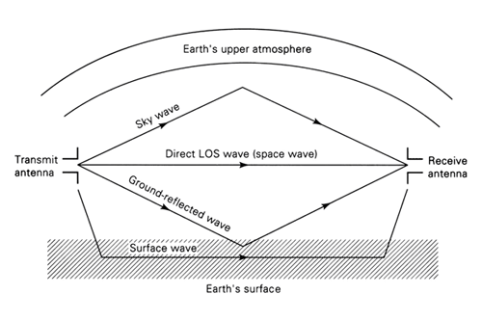
Radio wave propagation issues in personal wireless systems

Slide 19
Propagation models
Radio Waves are types of electromagnetic Radiation. they are produced by the acceleration of electromagnetic charges. Radio waves play an important role in communication, navigation, weather forecasting, medical imaging technology, etc. These waves have the longest wavelength in the electromagnetic spectrum.
Propagation of Radio Waves
Radio waves can propagate through air, water, various solid objects, vacuum and etc. The ability of radio waves to propagate through various materials depends on the wavelength and the frequency of the radio waves.
Modes of Radio Wave Propagation
There are three main modes of propagation of radio waves: ground wave, sky wave, and space wave.
Sky Wave Propagation: This mode of propagation occurs when the signal is transmitted by the transmitting antenna (Tx) is reflected by the ionosphere layer (sky) and received by the receiving antenna (Rx) is known as sky wave propagation. The ionosphere is the layer of the earth’s upper atmosphere that contains ionized gases and plasma. It protects the earth from harmful radiation.

Slide 20

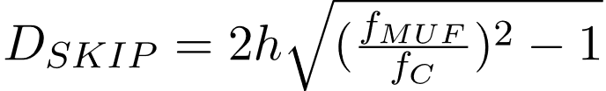
Propagation models
1.Sky wave propagation occurs in the ionosphere.
The range of frequencies that can be used for sky wave propagation is typically between 3 and 30 MHz.
The range of sky wave propagation is affected by the angle at which the radio waves enter the ionosphere, the height of the ionosphere, and the density of the ionosphere.
The critical frequency in Hz : here, Nmax is the maximum electron density per m3
The skip distance is given as :
Here, DSKIP is skip distance h is the height at which reflection happens fMUF is a maximum usable frequency fc is the critical frequency

Slide 21
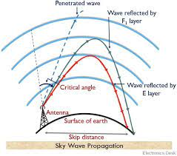
Propagation models

Slide 22
Space wave propagation
Propagation models
Space wave propagation is defined for the radio waves that occur within the 20km of the atmosphere ie; troposphere, comprising of a direct and reflected waves.
These waves are also known as tropospheric propagation as they can travel directly from the earth's surface to the troposphere surface of the earth.

Slide 23
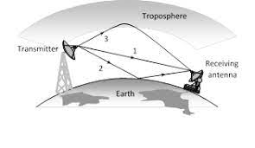
Propagation models
SPACE WAVE PROPAGATION

Slide 24
Ground wave propagation
Propagation models
Ground wave propagation is a type of radio propagation which is also known as a surface wave. These waves propagate over the earth's surface in low and medium frequencies. These are mainly used for transmission between the surface of the earth and the ionosphere. These are made up of the number of constituent waves.

Slide 25
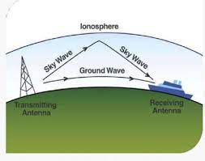
Propagation models
Ground wave propagation

Slide 26
Channel noise and losses
Channel noise and losses are important concepts in various fields, including telecommunications, information theory, and signal processing. They describe the degradation of signals as they are transmitted through a communication channel. Let's explore these concepts in more detail:
Channel Noise:
Definition:Channel noise and losses Channel noise refers to any unwanted or random interference or disturbance that affects a signal as it travels through a communication channel. This noise can be caused by various factors, including electronic components, environmental conditions, and electromagnetic interference.

Slide 27
Channel noise and losses
2. Types of Noise:
Additive White Gaussian Noise (AWGN): This is a common type of noise that is often modeled as a random signal with a Gaussian (normal) distribution and a mean of zero. AWGN is frequently used to model the noise in communication systems.
Impulse Noise: Irregular and sudden spikes in signal intensity that can disrupt communication.
Thermal Noise: Also known as Johnson-Nyquist noise, it is caused by the thermal agitation of electrons in conductors and is present in all electronic components.
Shot Noise: Arises due to the discrete nature of electrical charge carriers, such as electrons.
3. Effects: Channel noise can corrupt the information carried by the signal, making it more challenging for the receiver to accurately decode the transmitted data .

Slide 28
Channel noise and losses
Channel Losses:
Definition: Channel losses refer to the reduction in signal power or quality as it propagates through a channel. These losses can occur due to various factors and are typically expressed in decibels (dB).

Slide 29
Channel noise and losses
Types of Losses:Free-Space Path Loss: In wireless communication, as the signal travels through space, it spreads out and becomes weaker with distance. This is described by the free-space path loss formula.
.

Slide 30
Channel noise and losses
Attenuation: In wired communication, signals can experience attenuation (reduction in signal strength) as they travel along transmission lines or cables due to factors like resistance, dielectric losses, and skin effect.
Multipath Fading: In wireless communication, the signal may take multiple paths to reach the receiver, resulting in constructive and destructive interference, leading to fading.
Effects: Channel losses reduce the signal-to-noise ratio (SNR), making it more challenging for the receiver to distinguish the signal from the background noise. This can result in errors in data transmission.

Slide 31
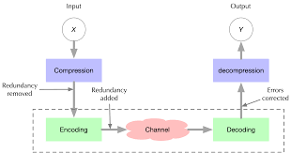
Channel noise and losses

Slide 32
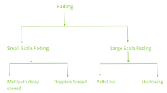
Fading
In wireless communication, fading is a phenomenon in which the strength and quality of a radio signal fluctuate over time and distance. Fading is caused by a variety of factors, including multipath propagation, atmospheric conditions, and the movement of objects in the transmission path.

Slide 33
Fading
There are several types of fading that can occur in land mobile systems:
Slow Fading: Slow fading, also known as large-scale fading, is caused by changes in the signal path over relatively long distances. This can be due to the mobile device moving through different environments, such as moving from an open area to an urban environment with buildings or trees. Slow fading typically occurs over a time scale of seconds to minutes.
Fast Fading: Fast fading, also known as small-scale fading, is characterized by rapid and short-term variations in signal strength due to multipath propagation. Multipath occurs when a signal takes multiple paths to reach the receiver due to reflections, diffraction, and scattering of the signal off obstacles like buildings or terrain. These multiple signal components can interfere constructively or destructively, leading to rapid signal strength variations, which occur over a time scale of microseconds to milliseconds.
Doppler Fading: Doppler fading is related to the motion of the mobile device or the base station. If either the transmitter or receiver is in motion relative to each other, the frequency of the received signal can shift due to the Doppler effect. This can result in frequency selective fading, where certain frequency components of the signal experience more significant fading than others.

Slide 34
Fading
Shadowing: Shadowing, also known as log-normal shadowing or log-distance path loss, is a type of slow fading that results from obstacles or terrain between the transmitter and receiver. It causes a gradual reduction in signal strength over distance and is often modeled as a log-normal random variable.
To mitigate the effects of fading in land mobile systems, various techniques are employed, including:

Slide 35
Fading
Diversity Techniques: Diversity reception, such as antenna diversity or frequency diversity, can be used to combat fading. By using multiple antennas or frequencies, a receiver can select the best signal among the diverse paths, reducing the impact of fading.
Equalization: Equalization techniques are used to mitigate the effects of multipath fading by attempting to reverse the distortion caused by the multiple signal paths.
Coding and Error Correction: Error-correcting codes are used to recover lost or corrupted data due to fading. By adding redundancy to transmitted data, errors can be detected and corrected at the receiver.
Power Control: Dynamic power control at the transmitter can be used to adapt the transmitted power based on the quality of the received signal, helping to maintain a reliable link in the presence of fading.
Frequency Hopping: Frequency-hopping spread spectrum techniques can help spread the effects of fast fading over a wider bandwidth, reducing the impact of fading on a particular frequency.
In summary, fading is a common issue in land mobile communication systems, and it can result from various factors. Mitigation techniques are essential to ensure reliable wireless communication in the presence of fading effects.

Slide 36
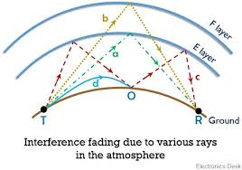
Fading

Slide 37
Multipath fading
Multipath fading is a phenomenon that occurs in wireless communication systems, especially in environments with obstacles, buildings, or other reflecting surfaces. It is a common challenge in wireless communication that can lead to signal degradation and disruptions. Here's an explanation of what multipath fading is and how it affects wireless communication:
Signal Propagation: When a wireless signal is transmitted from a transmitter (e.g., a cell tower or Wi-Fi router) to a receiver (e.g., a smartphone or computer), it travels through the air. However, in real-world environments, the signal doesn't always take a direct path from the transmitter to the receiver. Instead, it can bounce off surfaces like buildings, trees, or vehicles, taking multiple paths to reach the receiver.
Interference: These multiple paths can cause interference when they recombine at the receiver. If the signals from these paths arrive in phase (constructive interference), they can strengthen the received signal. Conversely, if they arrive out of phase (destructive interference), they can cancel each other out, leading to signal fading.

Slide 38
Multipath fading
Fading Types:
Rayleigh Fading: In this type of fading, the amplitude of the received signal varies randomly over time due to the multiple paths and phase differences. Rayleigh fading is often used to model the effects of multipath propagation in wireless channels.
Rician Fading: Rician fading occurs when there is a dominant direct line-of-sight path in addition to the scattered multipath components. This results in a more predictable signal fading pattern compared to Rayleigh fading.
Nakagami Fading: Nakagami fading is a generalization of Rayleigh fading that allows for a wider range of fading conditions, including more severe and less severe fading.
Impact on Communication: Multipath fading can severely degrade the quality of wireless communication by causing signal strength fluctuations, data errors, and dropped calls. It is a significant challenge in designing reliable wireless systems.

Slide 39
Multipath fading
Mitigation Techniques:
Diversity Techniques: Using multiple antennas at both the transmitter and receiver can help combat fading effects by improving the chances that at least one antenna receives a good signal.
Equalization: Digital signal processing techniques like equalization can be used to mitigate the effects of multipath fading by compensating for signal distortions.
Frequency and Time Diversity: By transmitting the same information over multiple frequency channels or at different times, fading can be reduced as the chances of all channels or time slots fading simultaneously are lower.

Slide 40
Multipath fading
Channel Models: Engineers and researchers often use mathematical models like the Rayleigh or Rician fading models to simulate and study the effects of multipath fading in wireless communication systems.
multipath fading is a phenomenon in wireless communication where signals take multiple paths due to reflections and interference, leading to fluctuations in signal strength at the receiver. It is a significant challenge in wireless system design, and various techniques are employed to mitigate its effects and improve communication reliability.

Slide 41
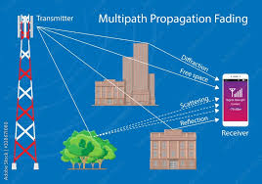
Multipath fading

Slide 42
Fading Effects on Signal and Frequency
Fading effects in the context of signal transmission refer to the variations in the strength or quality of a received signal as it travels from a transmitter to a receiver. These variations can occur due to a variety of factors, including:
Path Loss: As a signal travels through a medium (e.g., air, water, or space), it naturally spreads out and loses energy over distance. This phenomenon is known as path loss, and it leads to a decrease in signal strength with increasing distance from the transmitter.
Free-Space Path Loss: In free space (e.g., in outer space or a vacuum), the signal strength decreases with the square of the distance from the transmitter. This is described by the inverse square law.
Multipath Propagation: Signals can take multiple paths to reach the receiver due to reflections, diffractions, and scattering. These multiple paths can interfere constructively or destructively, causing signal fading. Multipath fading is often described as Rayleigh or Rician fading, depending on the nature of the multipath environment.
Doppler Effect: If either the transmitter or the receiver is in motion relative to each other, the frequency of the received signal can shift due to the Doppler effect. This can result in frequency fading.

Slide 43
Fading Effects on Signal and Frequency
Atmospheric Effects: Weather conditions and atmospheric elements like rain, fog, or atmospheric turbulence can scatter or absorb radio waves, leading to signal attenuation and fading.
Obstructions: Physical obstacles such as buildings, trees, or terrain can block or attenuate signals, causing shadowing and fading in certain areas.
Interference: Interference from other electronic devices or signals can affect the quality of the received signal, leading to fading effects.
Fading can be detrimental to signal quality and can lead to communication errors and decreased performance. To mitigate fading effects, various techniques are used in wireless communication systems, including:
Error-Correcting Codes: These codes can detect and correct errors in received signals, improving reliability.
Diversity Techniques: Techniques like space diversity (using multiple antennas) and time diversity (retransmitting data at different times) can help combat fading.

Slide 44
Fading Effects on Signal and Frequency
Equalization: Adaptive equalization techniques can be used to compensate for the effects of multipath fading.
Fading Simulation: In some cases, fading can be modeled and simulated to develop communication systems that are robust in fading environments.
Frequency Diversity: Transmitting the same information over multiple frequency channels can help reduce the impact of fading at specific frequencies.
Power Control: Adjusting the transmitted power based on the channel conditions can help maintain a consistent signal quality.
Fading effects are a significant consideration in the design and operation of wireless communication systems, and various strategies are employed to ensure reliable and robust communication, even in challenging propagation environments.

Slide 45
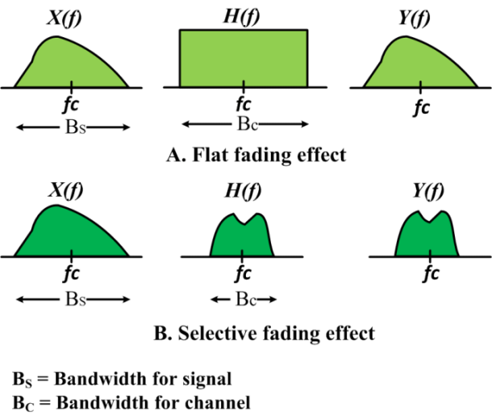
Fading Effects on Signal and Frequency

Slide 46
Shadowing
Shadowing is a language learning technique where a learner listens to a native speaker or an advanced speaker of the target language and attempts to repeat what they are saying as closely as possible, mimicking their pronunciation, intonation, and rhythm. It is a form of active listening and speaking practice commonly used to improve language skills, especially in the context of acquiring a new language or improving fluency in a second language.
Here's how shadowing typically works:
Choose a Source: Find audio or video materials in the target language that match your current proficiency level. This could be podcasts, news broadcasts, dialogues from movies or TV shows, or language learning resources.
Listen Actively: Put on the audio or video and listen carefully to the speaker's pronunciation, tone, and cadence. Try to focus on understanding the content as well.
Repeat Aloud: As you listen, simultaneously repeat what the speaker is saying out loud. Try to mimic their pronunciation, intonation, and rhythm as closely as possible. Don't worry too much about understanding every word at this stage.

Slide 47
Shadowing
Pay Attention to Details: Pay close attention to how the speaker articulates individual sounds, words, and phrases. Try to match their pronunciation and stress patterns.
Increase Speed and Accuracy: As you become more comfortable, gradually increase the speed at which you shadow. The goal is to keep up with the speaker as closely as possible while maintaining accuracy.
Record Yourself: Consider recording your shadowing sessions so you can review your progress and identify areas that need improvement. Listening to your own pronunciation can help you make corrections.
Repeat Regularly: Consistency is key in language learning. Practice shadowing regularly to see improvement over time. You can use a variety of materials to keep things interesting and challenging.
Shadowing is a valuable technique because it helps learners develop better pronunciation, rhythm, and intonation, which are crucial aspects of language fluency. It also trains your listening skills and can improve your overall understanding of the language. Additionally, it can be done independently, making it a convenient and accessible language learning tool.

Slide 48
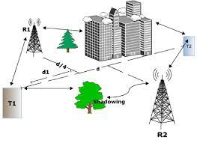
Shadowing

Slide 49
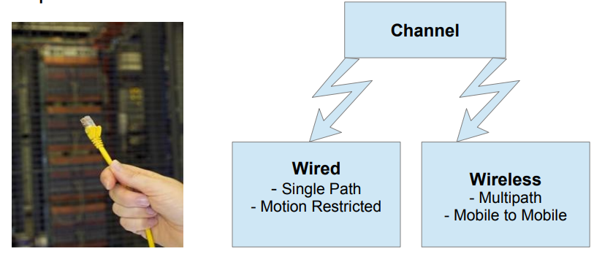
Introduction Channel Model
What is channel?
A Communication Channel is the medium used to transmit information from one point to the other.
Though wired channels are fast, cost-effective and secure, they are short ranged, motion restricted.

Slide 50

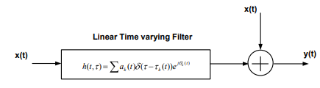
Channel Model
To model the wireless channels, consider for each point in the 3-dimensional space, the wireless channel is a linear time-varying filter with the following impulse response-

Slide 51
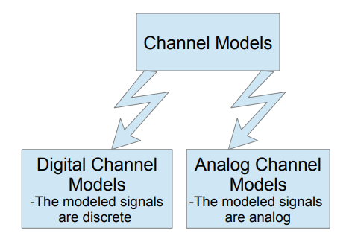
Channel Modeling
Ideally, modeling a channel is calculating all the physical processing effecting a signal from the transmitter to the receiver.
Why do we need to model?

Slide 52
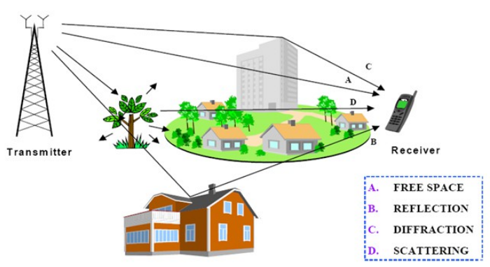
Wireless Channel Modeling
Three main mechanisms of electromagnetic wave prorogation are:
1) Reflection
2) Diffraction
3) Scattering

Slide 53
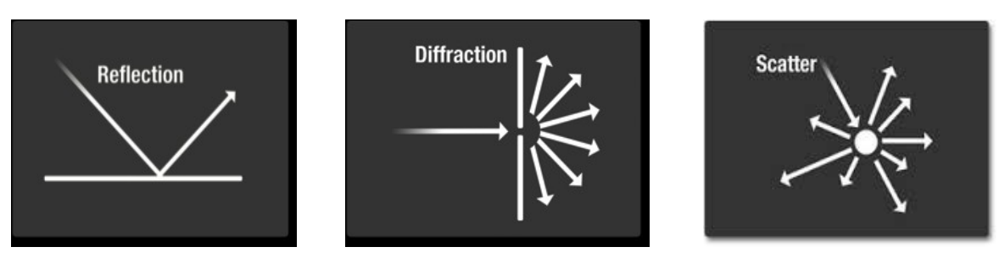
Wireless Channel Modeling
Reflection, Diffraction & Scattering

Slide 54
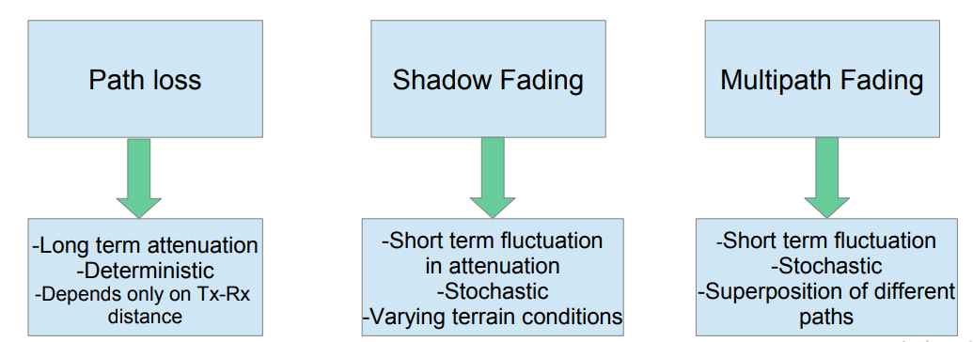
Wireless Channel Modeling
Due to these EM wave propagation mechanisms, radio propagation can be roughly described by three nearly independent phenomenon :

Slide 55

Wireless Channel Modeling
The total attenuation can be decomposed into path loss, shadowing and multipath fading as follows:
In this presentation, we shall focus more on the modeling and simulation of multipath fading.
Multipath fading in wireless communication systems is commonly modeled by Rayleigh and Rician distributions.

Slide 56
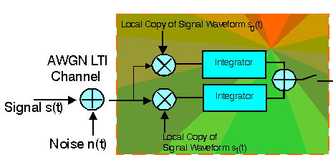
Additive White Gaussian Noise Channel
A basic and generally accepted model for thermal noise in communication channels, is the set of assumptions that
the noise is additive, i.e., the received signal equals the transmit signal plus some noise, where the noise is statistically independent of the signal.
the noise is white, i.e., the power spectral density is flat, so the autocorrelation of the noise in time domain is zero for any non-zero time offset.
the noise samples have a Gaussian distribution.

Slide 57
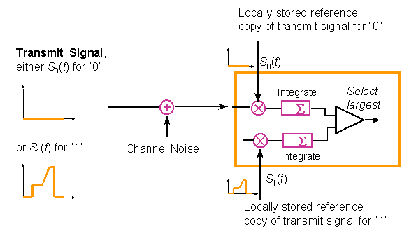
Additive White Gaussian Noise Channel
The matched filter correlates the incoming signal with a locally stored reference copy of the transmit waveform. The matched filter maximizes the signal-to-noise ratio for a known signal. It can be shown to be the optimal detector if
the channel produces Additive White Gaussian Noise (AWGN),
the channel is linear and time-invariant (LTI), and
an exact time reference is available, the signal amplitude as a function of time is precisely known.

Slide 58
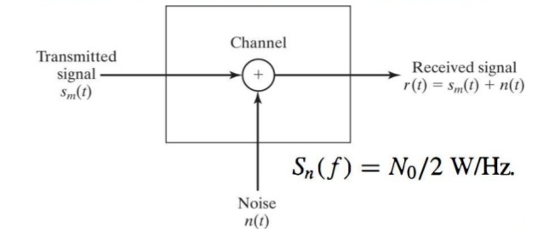
Additive White Gaussian Noise Channel
In this model, the transmitted signal gets disturbed by only a simple additive white Gaussian noise process.
The white noise is a noise which has a frequency spectrum that is continuous and uniform over a specified frequency band.
In AWGN channel model, there is no random scattering and diffraction transmitted signals at the receiver.

Slide 59
Fading Channel
Multipath fading is due to the constructive and destructive combination of randomly delayed, reflected, scattered and diffracted signal components.
Depending on the nature of the radio propagation environment, there are different models describing the statistical of the multipath fading channel like Rayleigh, Nakagami-q, Nakagami-n (Rice) and Nakagamim model.

Slide 60
Fading Channel
The delay should be much shorter than the duration of the transmitted symbol. Even if it is shorter than a single cycle the multipath could be due to a reflection from a building, the ground or trees and that can cause a phase reversal.
Thus the type of fading depends on various parameters of the channel and the transmitted signal. Fading can be considered as a (possibly) time varying filtering operation.
1. Frequency Selective Fading: If the transfer function of the filter has significant variations within the frequency band of the transmitted signal then the fading is called frequency selective.
2. Time Selective Fading: If the fading changes relatively quickly (compared to the duration of a data bit) then the fading is said to be time selective.
3. Doubly Selective: If both are true then it is said to be doubly selective.

Slide 61
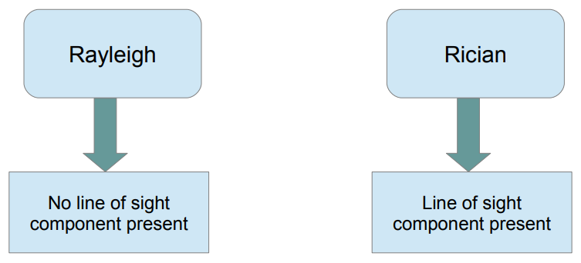
Rayleigh and Rician distributions
A close approximation of attenuation due to multipath fading in wireless channels can be done by Rayleigh fading (for the case where no line of sight component present) and Rician fading (for the case where line of sight component present).

Slide 62
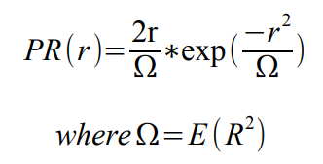
Rayleigh Distribution
The Rayleigh distribution is frequently used to model multipath fading with no direct line of sight (LOS) path. A Rayleigh Random Variable R has the probability distribution:
Rayleigh distribution can also be got by taking two independent and identically distributed zero mean Gaussian random variables as real and imaginary parts of a complex number and then taking its magnitude.

Slide 63
Rayleigh Fading Model
For a wireless channel, the envelope of the channel response is modeled to have a Rayleigh distribution.
Rayleigh Fading is a reasonable model when there are many objects in the environment that scatter the radio signal before it reaches the receiver.

Slide 64
Delay spread & Doppler Spread
N paths
Different delays for each path – Delay Spread
Different attenuation for each path
Constant channel vs effect of motion
Change in the carrier frequency – Doppler Spread

Slide 65
Clarke's Model
Rayleigh fading model
Assumes isotropic scattering
Assuming linear relationship between input and output
Generating Rayleigh Channel model using two different Gaussian distributions.
Gans developed a spectrum analysis for Clarke's model to include the doppler effect.

Slide 66


Clarke's Model
Defining Tc(t) and Ts(t) be Gaussian random processes.
At any time, Tc and Ts are uncorrelated zero mean Gaussian random variables.
The channel response envelope, r(t), has a Rayleigh pdf.
As derived by Gans, Doppler shift can be included into this channel model by passing r(t) through the filter s(t) given by:

Slide 67
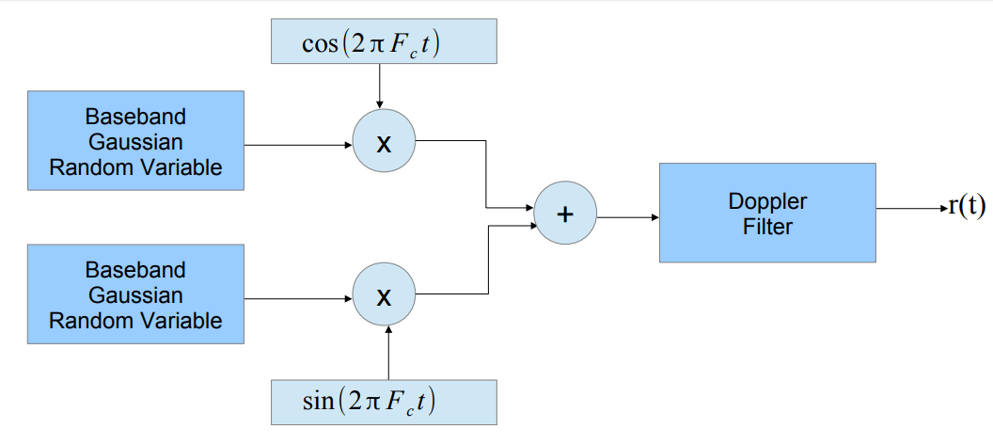
Clarke's Model

Slide 68
Clarke's model simulation algorithm (Rappaport)
Refer the section 'Clarke's Model for flat fading' in 'Wireless Communications – Principles and Practice' by Rappaport.
The steps are clearly given in the section 'Simulating Clarke's and Gans fading model' with a block diagram showing the frequency domain implementation of a Rayleigh fading simulator at baseband.
Repeat the above process to generate 3 such waveforms r(t) and find the cross correlation values among them. Tabulate it.

Slide 69

Rician Channel Model
The Rice distribution which is often used to model propagation paths consisting of one strong direct LOS component can be characterized by:
Where n is the Nakagami- n fading parameter, which ranges from 0 to ∞. I0(.) is the zero order modified Bessel function of the first kind.

Slide 70

Rician Channel Model
The SNR of the channel, , is distributed (i.e. P ) according to a non central chi-square distribution given by,

Slide 71
Nakagami Fading Channel
Besides Rayleigh and Rician fading, refined models for the pdf of a signal amplitude exposed to mobile fading have been suggested.
Nakagami Math
The distribution of the amplitude and signal power can be used to find probabilities on signal outages.
If the envelope is Nakagami distributed, the corresponding instantaneous power is gamma distributed.
The parameter m is called the 'shape factor' of the Nakagami or the gamma distribution.
In the special case m = 1, Rayleigh fading is recovered, with an exponentially distributed instantaneous power
For m > 1, the fluctuations of the signal strength reduce compared to Rayleigh fading.

Slide 72
Nakagami Fading Channel
The Nakagami fading model was initially proposed because it matched empirical results for short wave ionospheric propagation.
In current wireless communication, the main role of the Nakagami model can be summarized as follows:
When does Nakagami Fading occur?
It describes the amplitude of received signal after maximum ratio diversity combining.
After k-branch maximum ratio combining (MRC) with Rayleigh-fading signals, the resulting signal is Nakagami with m = k. MRC combining of m-Nakagami fading signals in k branches gives a Nakagami signal with shape factor mk.

Slide 73
Nakagami Fading Channel
When does Nakagami Fading occur?
The sum of multiple independent and identically distributed (i.i.d.) Rayleigh-fading signals have a Nakagami distributed signal amplitude.
This is particularly relevant to model interference from multiple sources in a cellular system.

Slide 74
Faculty Video Links, Youtube & NPTEL Video Links and Online Courses Details
Youtube/other Video Links:
https://www.youtube.com/watch?v=GrLaF_EKcuk
https://www.youtube.com/watch?v=ZuLSFcRPhXo

Slide 75
Daily Quiz
For a nonfading signal component present, the small scale fading envelope distribution is ______ a) Rayleigh b) Gaussian c) Log normal d) Rician
Rician distribution degenerates to ________ distribution when the dominant component fades away. a) Log normal b) Gamma c) Rayleigh d) Gaussian
The envelope of a sinusoid plus bandpass noise has ____ a) Uniformly distributed b) Rayleigh c) Rician d) Gaussian

Slide 76
Daily Quiz
4. The time dispersive properties of wideband multipath channel are quantified by ______ and _______ a) Mean excess delay, rms delay spread b) Doppler spread, rms delay spread c) Doppler spread, coherence time d) Mean excess delay, Doppler spread
Frequency selective fading channels are also known as ________ a) Narrowband channel b) Wideband channel c) Amplitude varying channel d) Phase varying channel
The propagation model that estimates radio coverage of a transmitter is called ___________ a) Large scale propagation model b) Small scale propagation model c) Fading model d) Okumura model

Slide 77
Weekly Assignment
What is AWGN channel?
Draw the general model of a Frequency Hopping Spread Spectrum (FHSS) System and explain its basic concept.
Discuss various types of small scale fading based on multipath time delay spread. Distinguish between flat fading and frequency selective fading.
Explain Wideband Time Dispersive Channel Modeling.
Define both Rician Fading Channel and Nakagami Fading Channel.
What are the various modes of Propagation?
What is Duct Propagation
What do you mean by ground Wave Propagation.
What do you mean by Sky Wave Propagation.
What do you mean by Space Wave Propagation

Slide 78
MCQ s
Which of the following distribution is used for describing statistical time varying nature of received envelope of multipath component? a) Log normal distribution b) Levy distribution c) Rayleigh distribution d) Gaussian distribution
Envelope of the sum of two quadrature Gaussian noise signal obeys _________ distribution. a) Rayleigh b) Inverse Gaussian c) Nakagami d) Gamma
For a Rayleigh fading signal, mean and median differ by _______ a) 2 dB b) 10 dB c) 0.55 dB d) 100 dB

Slide 79
MCQ s
4. For a non-fading signal component present, the small scale fading envelope distribution is ______ a) Rayleigh b) Gaussian c) Log normal d) Rician
5. Rician distribution degenerates to ________ distribution when the dominant component fades away. a) Log normal b) Gamma c) Rayleigh d) Gaussian
6. The envelope of a bandpass noise is ______ a) Uniformly distributed b) Rayleigh c) Ricean d) Gaussian

Slide 80
MCQ s
7. The envelope of a sinusoid plus bandpass noise has ____ a) Uniformly distributed b) Rayleigh c) Rician d) Gaussian
8. What do you call an attenuation that occurs over many different wavelengths of the carrier? a) Rayleigh fading b) Rician fading c) Wavelength fading d) Slow fading
9. Which of the reception problems below that is not due to multipath? a) Delayed spreading b) Rayleigh fading c) Random Doppler shift d) Slow fading

Slide 81
Old Question Papers
Define Nakagami fading channel.
Explain the Rayleigh and Rician distribution fading model.
Explain the different type of fading in wireless communication.
Explain different indoor propagation models.
Explain and derive stochastic and flat fading.
What is Wideband dispersive channel modeling? Explain briefly.

Slide 82
Expected Questions for University Exam
Explain the Rayleigh and Rician distribution fading model.
Explain the different type of fading in wireless communication.
What is Nakagami fading channel. Explain briefly.
What is Wideband dispersive channel modeling? Explain briefly.

Slide 83
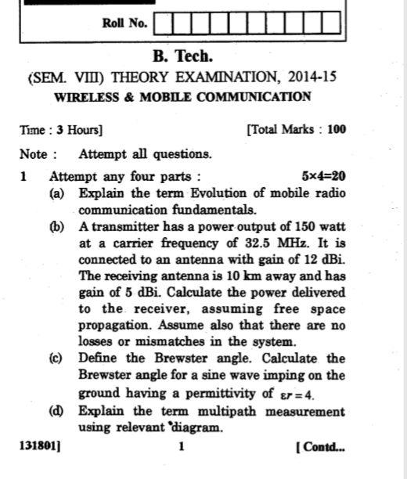
Old Question Papers

Slide 84
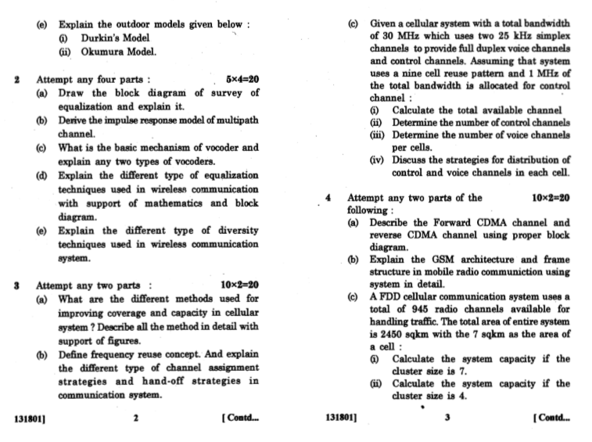
Old Question Papers

Slide 85
Thank You

